Slide 1

Capstone Project - II
SUPERVISED LEARNING - REGRESSION
TED-TALKS Views Predictions
Submitted By :
Aman Mishra

Slide 2

Contents
Overview
Data Description
Data Cleaning
Exploratory Data Analysis (EDA)
Feature Engineering
Outliers Treatment
Checking Multicollinearity
One Hot Encoding
Model Implementation
Model Comparison
Model Validation
Model Explainability
Summary & Conclusions

Slide 3


Overview
TED is devoted to spreading powerful ideas on just about any topic. These datasets contain over 4,000 TED talks over a span of three decades ,including transcripts in many languages.
Founded in 1984 by Richard Salman as a nonprofit organization that aimed at bringing experts from the fields of Technology, Entertainment, and Design,etc..TED Conferences have gone on to become the Mecca of ideas from virtually all walks of life.
As of 2015, TED and its sister TEDx chapters have published more than 2000talks for free consumption by the masses and its speaker list boasts of the likes of Al Gore, Jimmy Wales, Shahrukh Khan, and Bill Gates.
The main objective is to build a predictive model, which could help in predicting the views of the videos uploaded on the TEDx website.

Slide 4
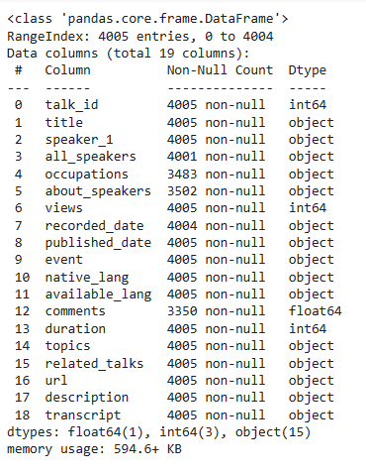

Data Description
Features mentioned in the dataset :
talk_id : Talk identification number provided by TED
title : Title of the talk
speaker_1 : First speaker in TED's speaker list
all_speakers : Speakers in the talk
occupations : Occupations of the speakers
about_speakers : Blurb about each speaker
recorded_date : Date the talk was recorded
published_date : Date the talk was published to TED.com
Event : Event or medium in which the talk was given
native_lang : Language the talk was given in
available_lang : All available languages (lang_code) for a talk
comments : Count of comments
duration : Duration in seconds
topics : Related tags or topics for the talk
related_talks : Related talks (key='talk_id',value='title')
url : URL of the talk
description : Description of the talk
transcript : Full transcript of the talk
The dataset contains following informations w.r.t TED events which will help in further processing of data

Slide 5
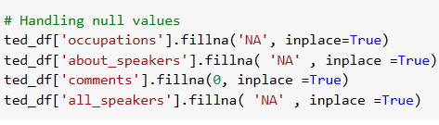
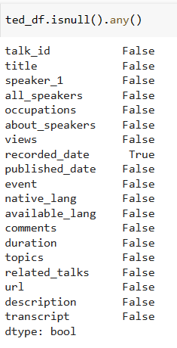

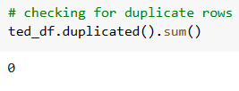
Data Cleaning
Handling Null Values
Removing Infinite values
Due to infinite values regression models fail to fit the dataset to models .
Duplicate Entries

Slide 6
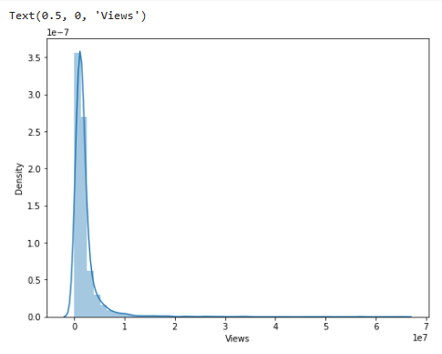
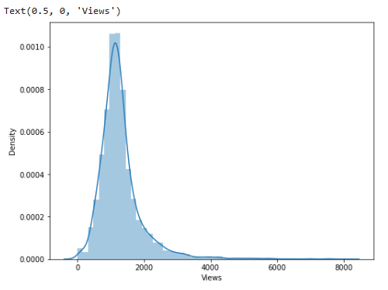
EDA
The dependent variable ‘Views’ is right / positively skewed
Before transformation
After using sqrt transformation

Slide 7
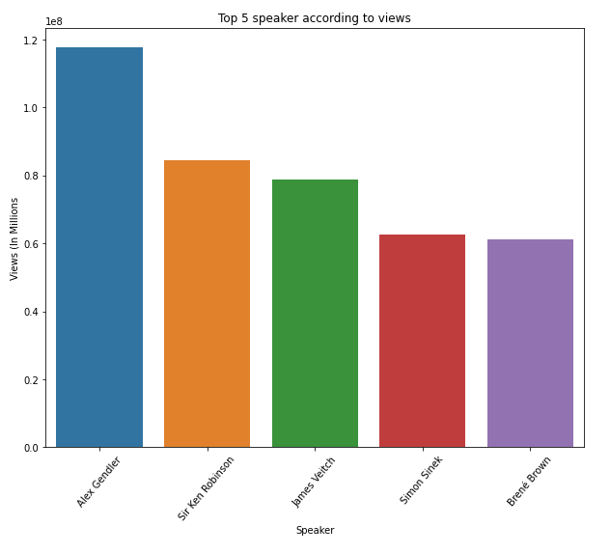
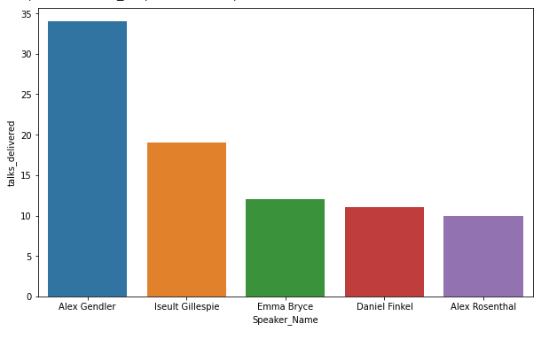
EDA
Top Speakers
Speakers with most talks delivered
Alex Gendler
Sir Ken Robinson
James Veitch
Simon Sinek
Brene Brown
Alex Gendler
Iseult Gillespie
Emma Bryce
Daniel Finkel
Alex Rosenthal

Slide 8
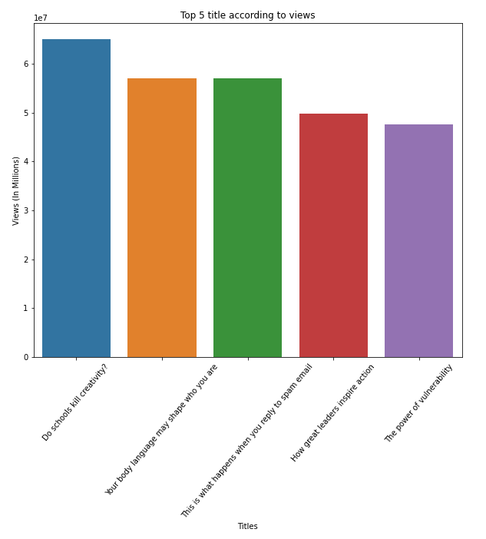
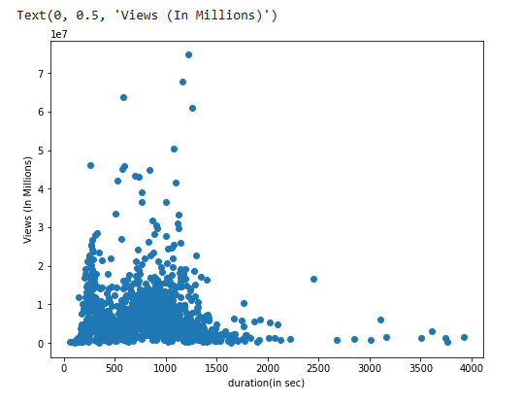
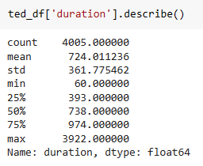
EDA
Top Titles
Duration V/s Views
Duration plot is heavily influenced by outliers , & relationship between duration & views is not linear
The average duration for TED events is around 724 seconds which is 12 minutes
Majority of TED events have time-duration of around 970 seconds which approximates to around 16 minutes , which is a very good time duration

Slide 9
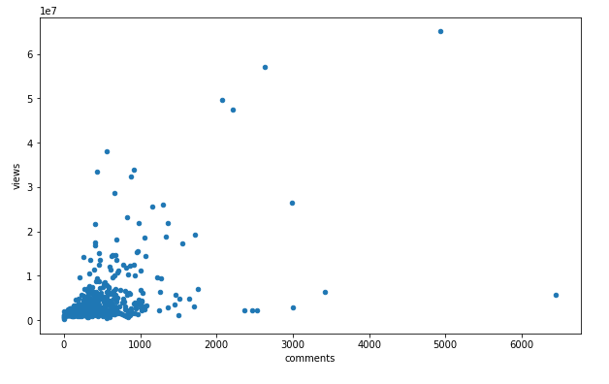
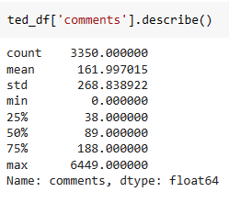
EDA
Comments V/s Views
There is slight correlation but it is heavily influenced by outliers
TED events receive an average of 90 , which is very less considering the popularity of TED events .
The maximum count of comments received are greater than 188 .

Slide 10
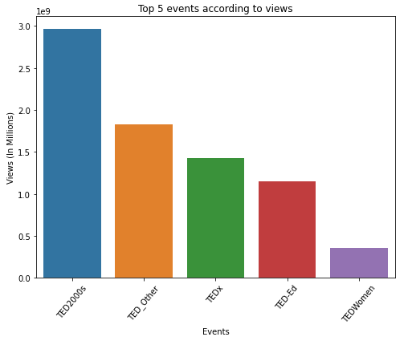
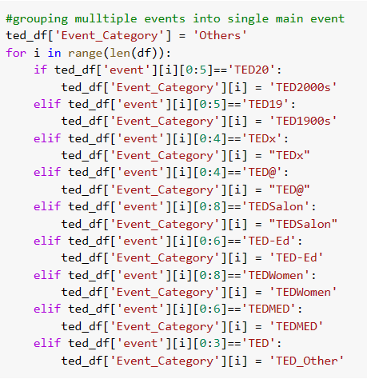
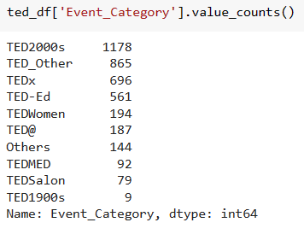
Feature Engineering
Grouping Events Together
Grouping events based on decades & unique suffixes to reduce complexity.
Majority of events uploaded by TED are in 2000s followed by TED_Other which contains various small events organised by TED
When grouped together it can be seen that , TED events happened in 2000s are the most viewed followed by TED_Other which contains various small events by TED

Slide 11
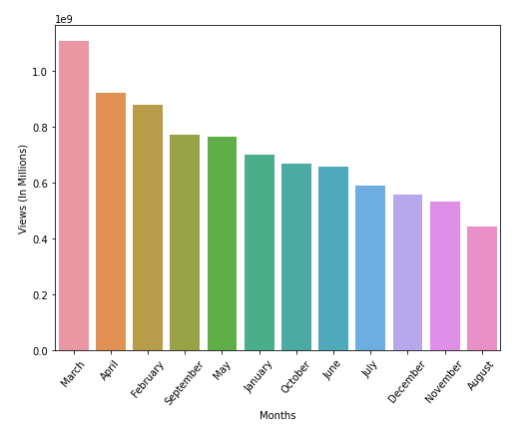
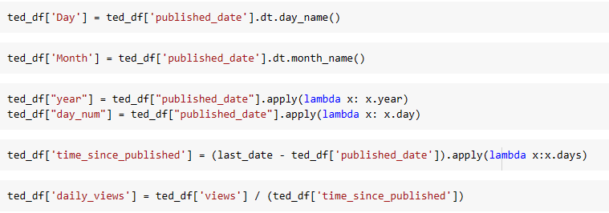
Feature Engineering
Creating Datetime features
Creating datetime features like Date ,Month ,Year ,Day and corresponding features from the given datetime dataset
March is the most popular month whereas , August the least w.r.t views generated

Slide 12
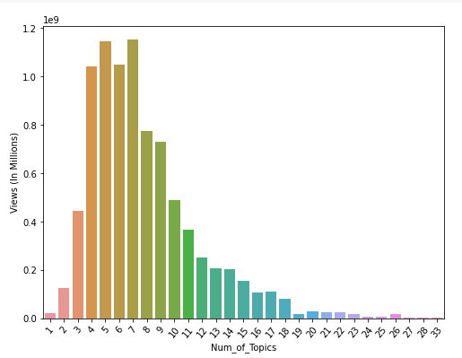
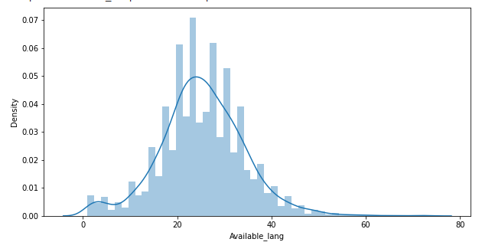
Feature Engineering
Finding Number of unique topics
Count of avalable_languages for events
Maximum views are generated when Num_of_topics lie in the range of 4-7 whereas , views go on decreasing as Num_of _Topics increases , which can be associated with increase in time duration for the event .
Average Count of number of languages individual TED events are available lies in range of 10-35, which explains its wide reach & popularity.

Slide 13
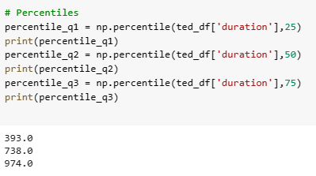
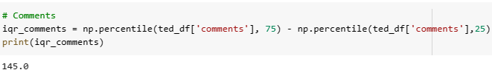
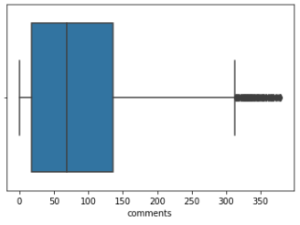

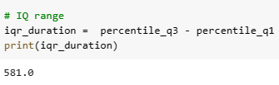
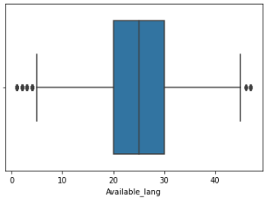
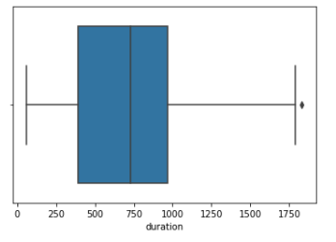
Outliers Treatment
As we have seen that duration, comments and Available_lang are heavily influeneced by outliiers.
Hence , for better model ouliers are treated using Inter-quartile Range (IQR) method
Duration
Comments
Available Languages

Slide 14
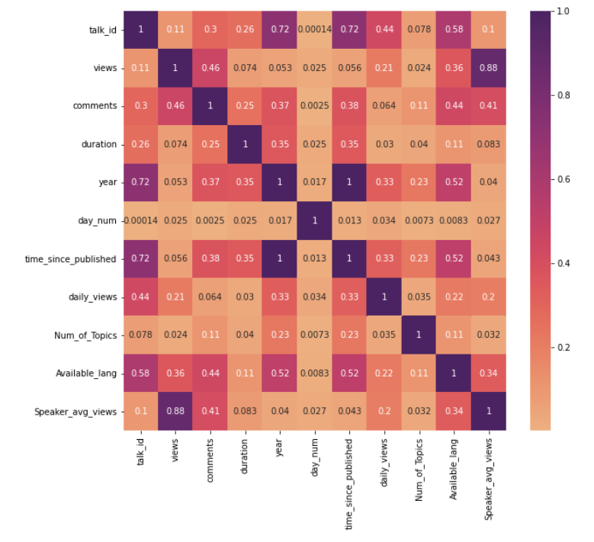
Checking Multicollinearity
Except Speaker_avg_views and views
There is No collinearity between any of the variables
This satisfies the conditions for implementation of Regression models

Slide 15
EDA Summary
Average of features / Mean is the measure of centrality for maximum views generated w.r.t some of the important features [ e.g. Duration, Number of unique topics ]
Hence, focus should be given on mainting the duration and number of topics to a speculated avg limit.
Number of languages a event is made available in should be maximum, as it reaches a wide-spread of audiences.
New added features [Event-Category , Day , Month , Daily views , Speaker Avg views , time_since_published etc. ] improves the interpretability of dataset.
Topics that involves the theme of self-imporvement , education , personality generates maximum views
No Multicollinearity present

Slide 16
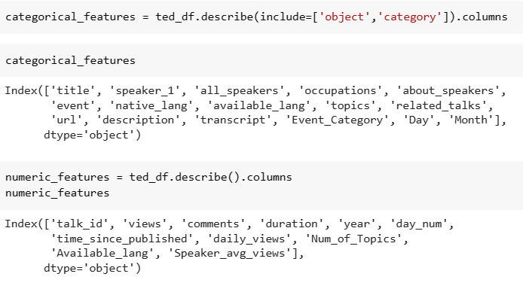
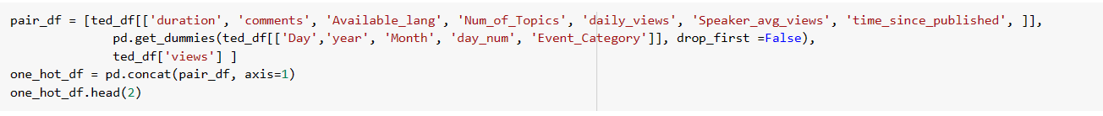
One Hot Encoding
Categorical & Numerical Features
Dummy variables of the object and date type variables is created.
Event_Category, Date, Month , Year , day_num can help in better prediction for the model
One Hot Encoding

Slide 17
Model Implementation
1. Linear Regression
1.1. Lasso Regression
1.2. Ridge Regression
1.3. Elastic-Net Regression
3. Decision Trees
3.1. Bagging Regression
3.2. Random Forest
3.3. Gradient-Boosting
4. XG-Boost Regression
5. KNN Regression

Slide 18
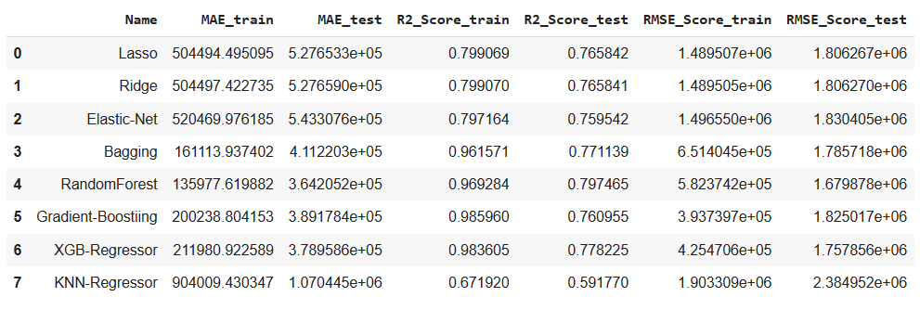
Model Comparison
Regression Evaluation Metrics for all the models

Slide 19
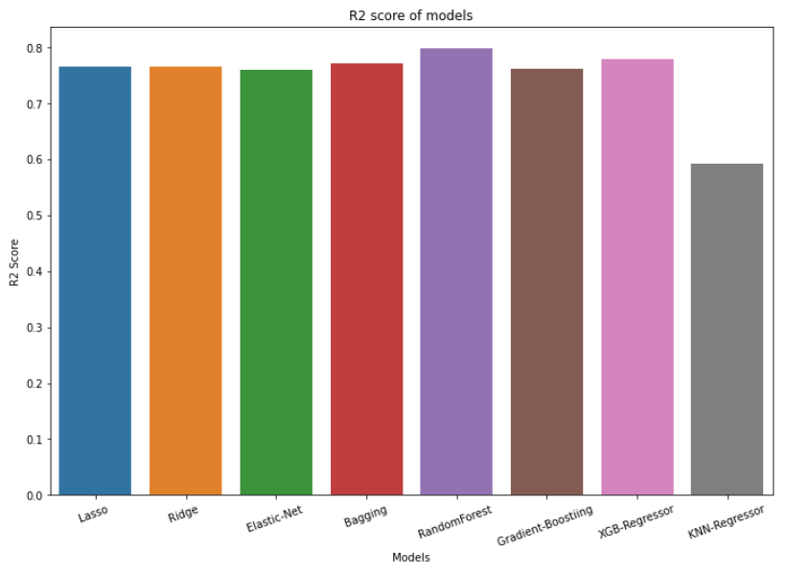
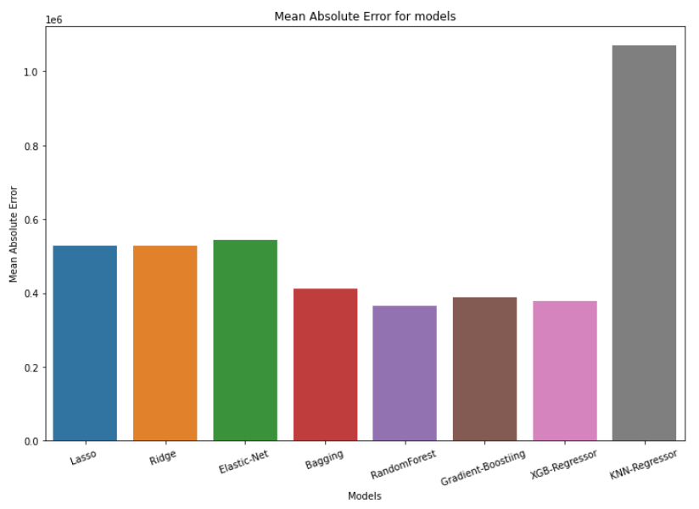
Model Comparison
R2 Score of models
Mean Absolute Error for Models

Slide 20
Model Comparison Summary
Linear Regression with Lasso & Ridge regularizations have a considerable R2 score but , also generate more error.
Decision Tree algorithm underwent the problem of overfitting.
Hence, ensemble techniques Bagging, Random-Forest , Gradient-Boosting & XG-boost were implemented.
All the ensemble techniques have a considerable R2 score, but what separates them is their error rate .
Bagging, Gradient-Boosting and XG-Boost have less and almost similar error-rate
Random Forest has the maximum R2 score as well the least MAE score and performs the best of all models.
KNN regressor has the worst performance of all models , which can be due to the fact that KNN generally works best with low dimensional data (less input variables )

Slide 21
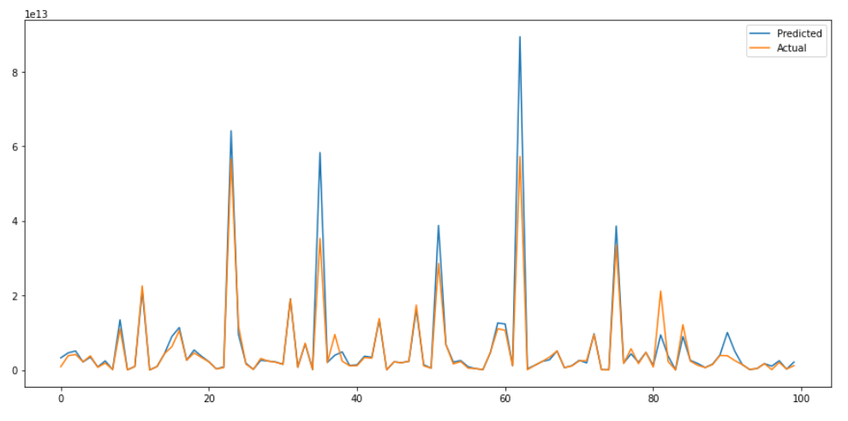
Model Validation
Actual & Predicted behaviour of Random Forest

Slide 22
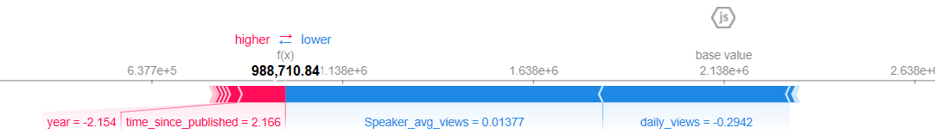
Model Explainability
We use SHAPLEY method for Model Explainability
From the plots we can see:
The model output value: 9.9 x 10^5
The base value: 2.14 x 10^6
Daily_views & Speaker_avg_views pushes the prediction lower , while time_since_published & year pushes the prediction on higher side.

Slide 23
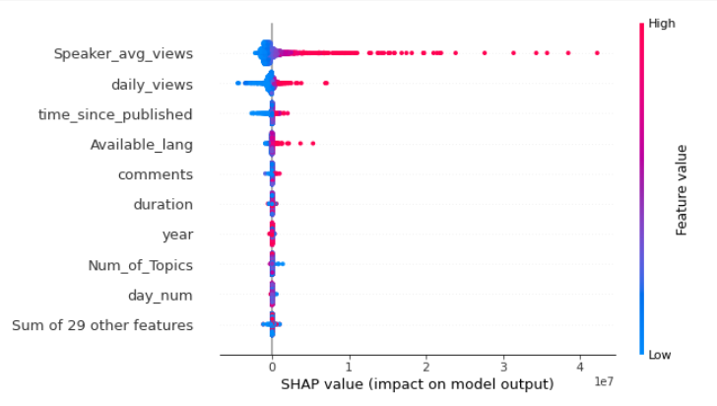
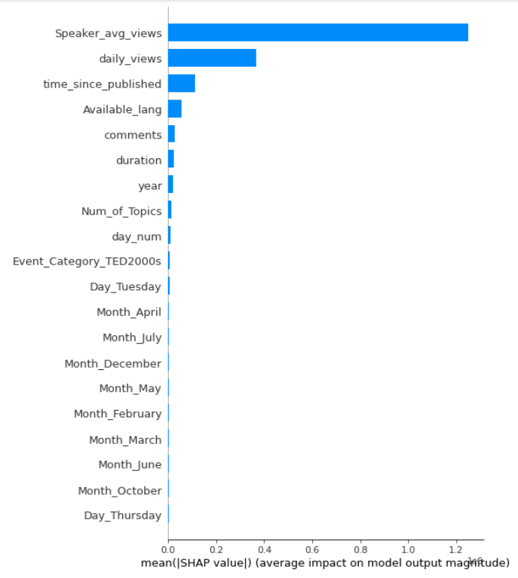
Model Explainability
Top features and their importance in model prediction
Speaker_avg_views , daily_views & time_since_published are the top features that impact the model performance

Slide 24
Summary & Conclusion
Summary :
We trained 8 Machine Learning models on training dataset by considering the best parameters for each model.
The performance of each model was evaluated using comparison graph between Predicted and Actual values and some Regression evaluation metrics.
We started with Linear regression, and further implemented regularizations to the same.
To further evaluate our dataset on more complex and restricted parameters , we used Decision Trees and its ensemble techniques.
Conclusion :
Features created from feature engineering play an important role in improving model performance .
Bagging, Gradient-Boosting and XG-Boost have almost similar scores.
Considering the Test_score XG-Boost gives better predictions with slightly low error than Gradient-Boosting.
But, considering the overall optimal values from errors and R2 score, Random-Forest has least errors and optimal R2 score for training and test dataset.

